Slide 1
An Empirical Study on Cryptocurrencies Price Prediction Using Different Machine Learning Classifier
Anubrata Sarkar, Utsab Talukder, Samriddhi Sarkar

Slide 2
All about Cryptocurrencies
(History, Application, Usage)

Slide 3
What is CryptoCurrency?
A cryptocurrency is a digital currency designed to work as medium of exchange through a computer network that is not reliant on any central authority, such as a government or bank, to uphold or maintain it.
Cryptocurrency does not exist in physical form and is typically not issued by a central authority. Cryptocurrencies typically use decentralized as opposed to a central bank digital currency(CBDC).

Slide 4
History of Cryptocurrencies
In 1983, the American cryptographer David Chaum conceived an anonymous cryptographic electronic money called ecash. Later, in 1995, he implemented it through Digicash, an early form of cryptographic electronic payments.
In 2009, the first decentralized cryptocurrency, Bitcoin, was created by developer Satoshi Nakamoto.
In June 2021, El salvador became the first country to accept Bitcoin as legal tender.

Slide 5
Can we use Cryptocurrency as investment option?
Cryptocurrencies are becoming popular every day. According to reports, more than 300 million people use cryptocurrency worldwide. Many businesses are accepting Bitcoin and other cryptocurrencies as payment methods.
Should You Invest In Cryptocurrency?
There are many advantages to dealing in cryptocurrencies, and a fair share of disadvantages as well. Here are the top three reasons that work in favor of and against cryptocurrencies.

Slide 6
Advantages:
They are private and secure: The blockchain technology that fuels cryptocurrencies ensures user anonymity. It also assures high levels of security through cryptography, which we discussed before.
They are decentralized, immutable, and transparent: The entire system functions on shared ownership, where data is available to all permissioned members and is tamper-proof.
They are a hedge against inflation: Cryptocurrency makes for a great investment in times of inflation. For example, investors often compare cryptocurrency to gold. One of the reasons behind this is that, just like gold, they are in limited supply, as there is a cap on mining any type of cryptocurrency.

Slide 7
Disadvantages:
They are not widely understood: They are a relatively new concept and the long-term sustainability of cryptocurrencies remains to be seen.
They are prone to high risks: Needless to say, cryptocurrencies bring in as many rewards as risks. Their highly volatile and speculative nature makes them prone to sharp downward spirals. Investing in cryptocurrency can be risky for many reasons.
A major deterrent could be the fact that digital currency seems to have no inherent or underlying value. There is a supply-demand type of equation that is used to determine the value of cryptos like bitcoins.

Slide 8

Can we see bitcoin as a long-term investment?
Bitcoin, as the most widely known cryptocurrency, benefits from the network effect -- more people want to own Bitcoin because Bitcoin is owned by the most people. Bitcoin is currently viewed by many investors as "digital gold," but it could also be used as a digital form of cash.
Bitcoin investors believe the cryptocurrency will gain value over the long term because the supply is fixed, unlike the supplies of fiat currencies such as the U.S. dollar or the Japanese yen. The supply of Bitcoin is capped at fewer than 21 million coins, while most currencies can be printed at the will of central bankers. Many investors expect Bitcoin to gain value as fiat currencies depreciate.

Slide 9
Cryptocurrencies Price Prediction on Bitcoin Using Different Machine Learning Classifier

Slide 10
Methodology
For this prediction we have used 4 types of different ML methods that are :
Long Short Term (LSTM)
Least Absolute Shrinkage and Selection ( LASSO)- Linear Regression
Gradient Boost
Random Forest Regression

Slide 11
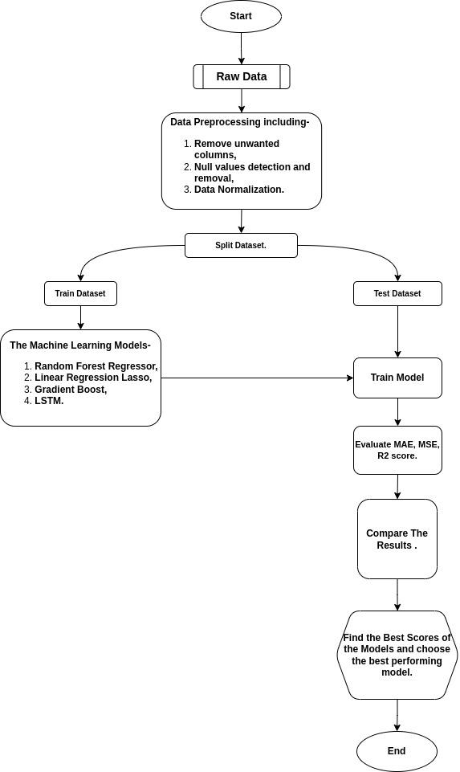
Flowchart

Slide 12
Result of Cryptocurrency Price Prediction Using Various Machine Learning Models.

Slide 13
Results Based on Train_test_split.
Random Forest Regressor
Split ratio | MAE | MSE
80:20 | 0.007832 | 0.000169
70:30 | 0.007960 | 0.000149
60:40 | 0.007213 | 0.000124
Linear Regression-Lasso
Split ratio | MAE | MSE
80:20 | 0.274308 | 0.091189
70:30 | 0.273553 | 0.090258
60:40 | 0.271493 | 0.088999
Gradient Boost
Split ratio | MAE | MSE
80:20 | 0.007914 | 0.000157
70:30 | 0.008264 | 0.000154
60:40 | 0.007831 | 0.000139
LSTM
Split ratio | MAE | MSE
80:20 | 0.016559 | 0.000522
70:30 | 0.018267 | 0.000799
60:40 | 0.015514 | 0.000476

Slide 14
Results Based on Grid Search CV.
RANDOM FOREST.
Parameter Grid:-
‘bootstrap’ : [True]
‘max_depth’ : [80,90,100,110]
‘max_features’ : [2,3]
‘mean_sample_leaf’ : [3,4,5]
‘min_samples_split’ : [8,10,12]
‘n_estimators’ : [100,200,300,1000]
GS Best Parameters For Train Part:-
max_depth=90,
max_features=3,
min_samples_leaf=3,
min_samples_split=8,
n_estimators=300
GS Best Parameters For Test Part:-
max_depth=110,
max_features=3,
min_samples_leaf=3,
min_samples_split=8,
n_estimators=100
GS Best Score.
TrainTest Ratio | Train Part | Test Part
80:20 | 0.998125 | 0.997195
70:30 | 0.997987 | 0.997632
60:40 | 0.997787 | 0.997743

Slide 15
Results Based on Grid Search CV.
Linear Regression-Lasso.
Parameter Grid:-
'alpha':[0,0.1,0.01,0.05,0.5,1]
'normalize':[True,False]
'selection':[‘cyclic’,’random’]
GS Best Parameters For Train Part:-
'alpha' = 0,
'normalize'= True,
'selection'='cyclic'
GS Best Parameters For Test Part:-
'alpha' = 0,
'normalize': True,
'selection': 'cyclic'
GS Best Score.
TrainTest Ratio | Train Part | Test Part
80:20 | 0.998952 | 0.999021
70:30 | 0.998964 | 0.998844
60:40 | 0.998913 | 0.998949

Slide 16
Results Based on Grid Search CV.
Gradient Boost.
Parameter Grid:-
'learning_rate':[0.01,0.02,0.0.,0.04]
'max_depth':[4,6,8,10]
'n_estimators':[100,500,1000,1500]
‘subsample’:[0.9,0.5,,0.2,0.1]
GS Best Parameters For Train Part:-
‘learning_rate’=0.04,
'max_depth’=8,
‘n_estimators’=1000,
‘subsample’=0.5
GS Best Parameters For Test Part:-
‘learning_rate’=0.02,
'max_depth’=8,
‘n_estimators’=1000,
‘subsample’=0.5
GS Best Score.
TrainTest Ratio | Train Part | Test Part
80:20 | 0.998363 | 0.997902
70:30 | 0.998287 | 0.998042
60:40 | 0.998123 | 0.997721

Slide 17
Results Based on Grid Search CV.
LSTM.
Parameter Grid:-
'batch_size':[20,32,40]
'epochs':[8,30,50]
'optimizer':[‘adam’,’adelta’,’rmsprop’]
GS Best Parameters For Train Part:-
'batch_size':=20
'epochs'=8
'optimizer'=’adelta’
GS Best Parameters For Test Part:-
'batch_size':=20
'epochs'=8
'optimizer'=’adam’
GS Accuracy.
TrainTest Ratio | Train Part | Test Part
80:20 | 0.002496 | 0.014925
70:30 | 0.002861 | 0.003333
60:40 | 0.001666 | 0.002506

Slide 18
Conclusion.
The way technology is advancing in the present age and the demand for cryptocurrency is increasing, it can be inferred that the use of machine learning in the crypto market will increase in the near future. In this context, we have tried our best to make the slightest contribution through this project.

Slide 19
Reference.
Sebastião, H., & Godinho, P. (2021). Forecasting and trading cryptocurrencies with machine learning under changing market conditions. Financial Innovation, 7(1), 1-30.
Jaquart, P., Dann, D., & Weinhardt, C. (2021). Short-term bitcoin market prediction via machine learning. The journal of finance and data science, 7, 45-66.
Ibrahim, A. A. (2020, November). Price prediction of different cryptocurrencies using technical trade indicators and machine learning. In IOP Conference Series: Materials Science and Engineering (Vol. 928, No. 3, p. 032007). IOP Publishing.
Azam, S., & Kumar, R. (2021). CryptoCurrency Price Prediction Using Machine Learning. International Journal of Recent Advances in Multidisciplinary Topics, 2(12), 56-58.
Garcia, D., & Schweitzer, F. (2015). Social signals and algorithmic trading of Bitcoin. Royal Society open science, 2(9), 150288.
Dataset API- www.cryptocompare.com.

Slide 20
The End.
Thank You
Any Question….?

